Slide 1





Flow 1
Flow 2
Flow 3
Flow 4
Flow 5
Managing
Stakeholders’
Requirements
Developing
Strategies and Capabilities
Pursuing
Business
Developing
Products and
Process
Providing Goods
and Services
Monitoring and Continually Improving

Slide 2
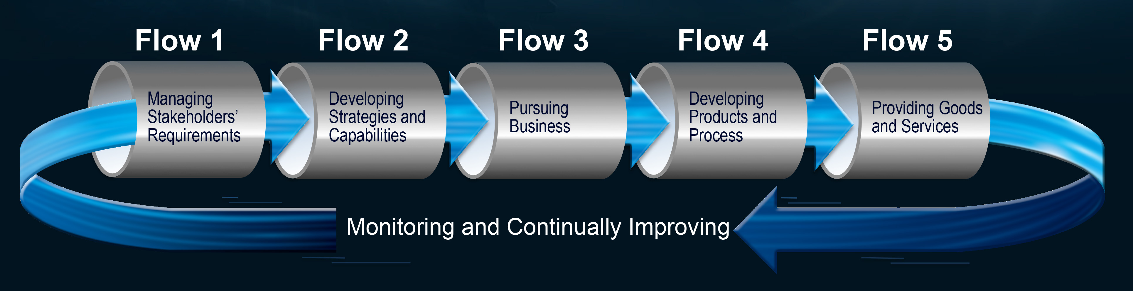
Flow 1
Flow 2
Flow 3
Flow 4
Flow 5
Managing
Stakeholders’
Requirements
Developing
Strategies and Capabilities
Pursuing
Business
Developing
Products and
Process
Providing Goods
and Services
Monitoring and Continually Improving

Slide 3
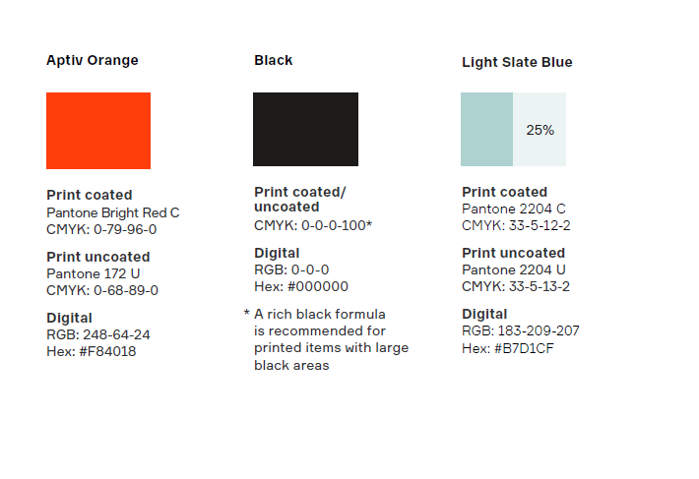




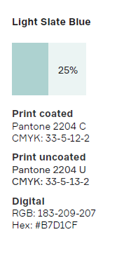

EOS Logo Update – Dec. 2017
E S
E S
Proposed, but not adopted for Aptiv EOS Use
Enterprise Operating System
Enterprise Operating System
E S
E S
ENTERPRISE OPERATING SYSTEM
ENTERPRISE OPERATING SYSTEM
Adopted for Aptiv EOS Use
E S
ENTERPRISE OPERATING SYSTEM
Font
Picture

Slide 4
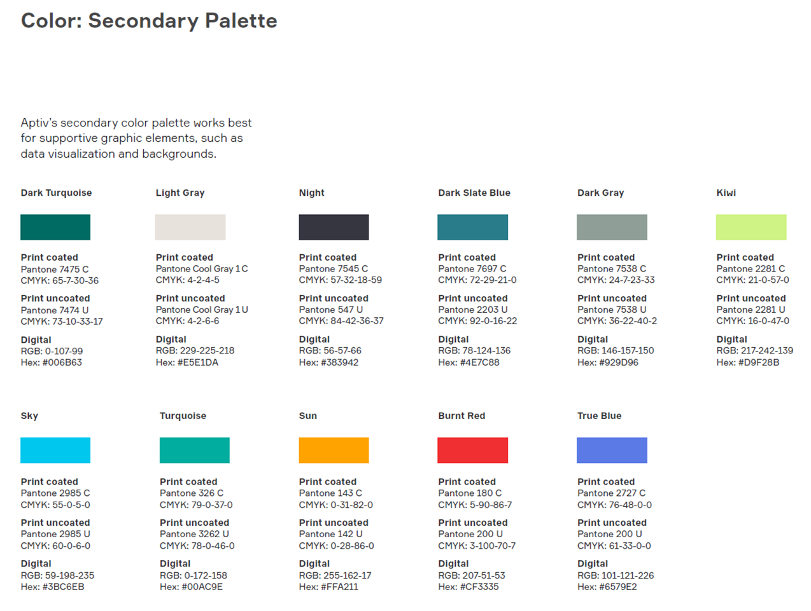
APTIV secondary color pallet

Slide 5
EOS Logo –
Discontinued with Delphi to Aptiv Conversion
E S
E S
Enterprise Operating System
Enterprise Operating System
Use only on very dark backgrounds
Background fill can be adjusted to match need
Most common use
Use with most backgrounds
“No Fill” the background or fill with white

